Slide 1
2.2 Methods of error detection
Understand the need to check for errors after data transmission and how these errors can occur
Describe the processes involved in each of the following error detection methods for detecting errors in data after transmission: parity check (odd and even), checksum and echo check
Describe how a check digit is used to detect errors in data entry and identify examples of when a check digit is used, including international standard book numbers (ISBN) and bar codes
Describe how an automatic repeat query (ARQ) can be used to establish that data is received without error

Slide 2
Today
Understand the need to check for errors after data transmission and how these errors can occur
Describe the processes involved in each of the following error detection methods for detecting errors in data after transmission: parity check (odd and even), checksum and echo check
Describe how a check digit is used to detect errors in data entry and identify examples of when a check digit is used, including international standard book numbers (ISBN) and bar codes
Describe how an automatic repeat query (ARQ) can be used to establish that data is received without error
Understand: Different types of error detection
Able: Find an error
Answer: Where we use check digits

Slide 3
Errors
Whenever you send data you can get errors.
We need to find (detect) and fix (correct) these errors
We will now look at different ways to detect errors
ARQ – Automatic ReQuests
Echo Check
Check digits
Checksums
Parity bit
Parity byte

Slide 4
ARQ
ARQ or Automatic Requests are super simple.
You send something
You wait
If the person gets it then they send something back (like “thank you” )
That’s it…. If you wait for too long then your thing is automatically sent again.
This waiting for too long is called ‘Timeout’
If something says timeout then it took too long for the receiver to get to get it

Slide 5
Echo Check
With ARQ you get a message back saying, “I got a message, thanks”
But you don’t know if it’s the correct message. You just know it was A message.
With an echo check:
You send data
The receiver gets your data
The receiver sends back the SAME data. It sends an echo
You check to see if it’s the same.
This way is so stupid.
If you have a large data file, now you have to send that large file back again!
And
Imagine you sent data and the receiver got the data perfectly. So now the receiver wants to send it back to you. Now you get this echo data but its wrong. How do you know if the original data was wrong or if the echo was wrong. Stupid way.

Slide 6
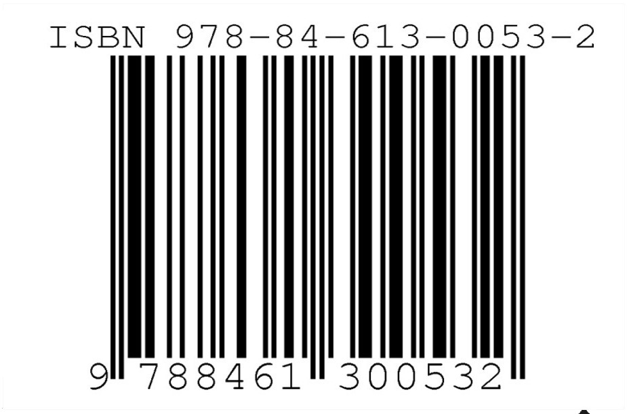
Check digits
Look at the barcode on your books –
it may be ISBN – 13.
ISBN = International Standard Book Number
That 13th number is a check digit

Slide 7
Check digit
Formula:
Add all the values in the odd positions
Add all the values in the even positions and * 3
Add both numbers and divide by 10
If the remainder is 0 then this is your check digit
If not 0, then: 10 - your remainder is your check digit

Slide 8
Example
314781364953 is your number:
Position | 1 | 2 | 3 | 4 | 5 | 6 | 7 | 8 | 9 | 10 | 11 | 12 | 13
 | 3 | 1 | 4 | 7 | 8 | 1 | 3 | 6 | 4 | 9 | 5 | 3
Add all values in odd positions
3 + 4 + 8 + 3 + 4 + 5 = 27
2. Add all values in even positions and * 3
(1 + 7 + 1 + 6 + 9 + 3) * 3 = 81
3. Add both numbers and divide by 10
(27 + 81) / 10 = 10.8
4. If remainder is 0 then 0 is your check digit
5. 10 – remainder = check digit
10 – 8 = 2

Slide 9
Example
314781364953 is your number:
Position | 1 | 2 | 3 | 4 | 5 | 6 | 7 | 8 | 9 | 10 | 11 | 12 | 13
 | 3 | 1 | 4 | 7 | 8 | 1 | 3 | 6 | 4 | 9 | 5 | 3 | 2
Add all values in odd positions
3 + 4 + 8 + 3 + 4 + 5 = 27
2. Add all values in even positions and * 3
(1 + 7 + 1 + 6 + 9 + 3) * 3 = 81
3. Add both numbers and divide by 10
(27 + 81) / 10 = 10.8
4. If remainder is 0 then 0 is your check digit
5. 10 – remainder = check digit
10 – 8 = 2

Slide 10
Task
What is the check digit for:
281746203842
184092462094
827147056773
092048059301

Slide 11
Checksum
This is a number that is sent after you sent your block of data
A checksum is a number you get based on your block of data, its usually a number under 256 (Because the highest number a byte can store is 255)
When you send data, the receiver checks the data and if it gets the same number then everything is fine. If the number is different then the receiver will ask you to send again

Slide 12
Checksum
If your block of data’s value is <=255 then this number is used as your checksum
Your block of data
172
Checksum
172

Slide 13
Checksum
If your data is larger than 255 then a formula is used
Divide your block by 256
Round DOWN to nearest integer (7.6 becomes 7)
Multiply by 256
Minus from your original block number

Slide 14
Example
Your block of data
3721
Divide by 256
14.5
Round DOWN
14
Multiply by 256
3584
Minus Original
3721-3584
Checksum
137

Slide 15
Task
What is the checksum for:
883 115
210 210
1972 180
2939 123
99 99

Slide 16
Play a game
2

Slide 17
Play a game
5

Slide 18
Play a game
62

Slide 19
Play a game
91

Slide 20
Play a game
682

Slide 21
Play a game
731

Slide 22
Play a game
00011

Slide 23
Play a game
101101

Slide 24
Play a game
1010

Slide 25
Play a game
1011011101

Slide 26
Parity bit
Before you send data, you must decide if you want even parity or odd parity
The parity bit is a special bit you put at the start of your original number
You take your original number and see if your original number is odd or even.
You decide if you want to send it as odd or even
You add a 1 or 0 at the start to make the whole number odd or even.
If you wanted to send the data: 0011011
Right now it’s even (there are four 1’s)
If you chose even parity then you will send:
00011011 – Because your original number is already even, you do NOT need to change anything so the first number can be a 0
If you chose odd parity then you will send:
10011011. Because original number was even, but you wanted to send odd, you must make the number odd. To make the number odd you put a 1 at the start. So now you have five 1’s and five is odd.

Slide 27
Parity Bit
What would I add for this:
Original | If I want Odd Parity | If I want Even Parity
1001101 | 11001101 | 01001101
1100100 | 01100100 | 11100100
0000111 | 00000111 | 10000111
0111111 | 10111111 | 00111111

Slide 28
Parity bit
So lets say you picked odd parity and sent 10011011
But an error happened and you received 10011111
Well, this now has six 1’s
Six is even and you said by sending the parity bit 1 that it should be odd.
So now you know something is wrong….but you don’t know where is the mistake, you just know there is a mistake.

Slide 29
Parity Bit
But this method is bad.
You know a mistake happened but don’t know where
And
If two bits changed you won’t even know there is a mistake.
I want to send 10011011 with odd parity (blue 1)
I receive 10011111 (Six 1’s – I know there’s an error)
I receive 10111111 (Seven 1’s – its odd so my parity bit is okay – I think its fine)

Slide 30
Parity Byte
Is when you send blocks of data
Read horizontal AND vertical
In the example we will use even parity

Slide 31
What I sent (even parity)
 | Bit 1 (parity) | Bit 2 | Bit 3 | Bit 4 | Bit 5 | Bit 6 | Bit 7 | Bit 8
Byte 1 | 0 | 0 | 1 | 1 | 0 | 0 | 1 | 1
Byte 2 | 1 | 0 | 0 | 0 | 0 | 1 | 1 | 1
Byte 3 | 1 | 1 | 0 | 0 | 0 | 0 | 0 | 0
Byte 4 | 0 | 0 | 1 | 1 | 1 | 1 | 1 | 1
Parity Byte | 0 | 1 | 0 | 0 | 1 | 0 | 1 | 1
If you look at each row then the number of 1’s are even (including the parity bit)
The parity byte (the last row) looks at the COLUMN if its even it puts a 0, and if it odd it puts a 1 .
So if you look at bit 4 column it had two 1’s, which is even so the parity byte for bit 4 is 0.
If you look at bit 5, it only had one 1, which is odd – we agreed to send even parity so we make the parity byte for bit 5 a 1. Now when we look at the column we read two 1’s and two is even

Slide 32
What I received(even parity)
 | Bit 1 (parity) | Bit 2 | Bit 3 | Bit 4 | Bit 5 | Bit 6 | Bit 7 | Bit 8
Byte 1 | 0 | 0 | 1 | 1 | 0 | 0 | 1 | 1
Byte 2 | 1 | 0 | 0 | 1 | 0 | 1 | 1 | 1
Byte 3 | 1 | 1 | 0 | 0 | 0 | 0 | 0 | 0
Byte 4 | 0 | 0 | 1 | 1 | 1 | 1 | 1 | 1
Parity Byte | 0 | 1 | 0 | 0 | 1 | 0 | 1 | 1
 | Bit 1 (parity) | Bit 2 | Bit 3 | Bit 4 | Bit 5 | Bit 6 | Bit 7 | Bit 8
Byte 1 | 0 | 0 | 1 | 1 | 0 | 0 | 1 | 1
Byte 2 | 1 | 0 | 0 | 1 | 0 | 1 | 1 | 1
Byte 3 | 1 | 1 | 0 | 0 | 0 | 0 | 0 | 0
Byte 4 | 0 | 0 | 1 | 1 | 1 | 1 | 1 | 1
Parity Byte | 0 | 1 | 0 | 0 | 1 | 0 | 1 | 1
There is an error.
Count the number of 1’s in each row- it should be an even number
This will tell you which byte has the error
Now count the columns – it should be an even number
You should now know where the error is

Slide 33
Example
Odd parity was agreed – where is the error?
 | Bit 1 (parity) | Bit 2 | Bit 3 | Bit 4 | Bit 5 | Bit 6 | Bit 7 | Bit 8
Byte 1 | 1 | 0 | 1 | 1 | 0 | 0 | 1 | 1
Byte 2 | 1 | 0 | 0 | 1 | 0 | 1 | 1 | 1
Byte 3 | 1 | 1 | 0 | 0 | 1 | 0 | 0 | 0
Byte 4 | 0 | 1 | 1 | 1 | 0 | 1 | 1 | 1
Parity Byte | 0 | 1 | 1 | 0 | 1 | 1 | 0 | 0

Slide 34
Example
Odd parity was agreed – where is the error?
 | Bit 1 (parity) | Bit 2 | Bit 3 | Bit 4 | Bit 5 | Bit 6 | Bit 7 | Bit 8
Byte 1 | 1 | 0 | 1 | 1 | 0 | 0 | 1 | 1
Byte 2 | 1 | 0 | 0 | 1 | 0 | 1 | 1 | 1
Byte 3 | 1 | 1 | 0 | 0 | 1 | 0 | 0 | 0
Byte 4 | 0 | 1 | 1 | 1 | 0 | 1 | 1 | 1
Parity Byte | 0 | 1 | 1 | 0 | 1 | 1 | 0 | 0

Slide 35
Taboo
One victim will sit here
You will write a word we have used on a post-it note
You can stick it on the victims head
Others will give a clue to this word
They cannot say the actual word or variation of the word
The victim must say the word

Slide 36
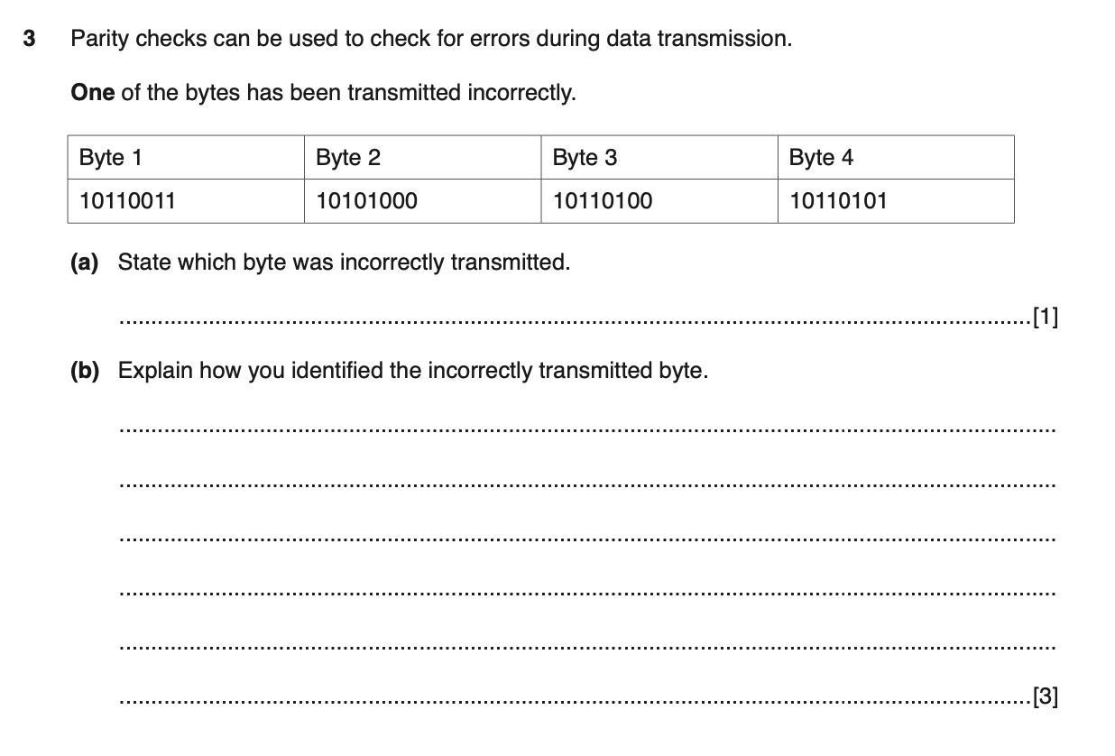
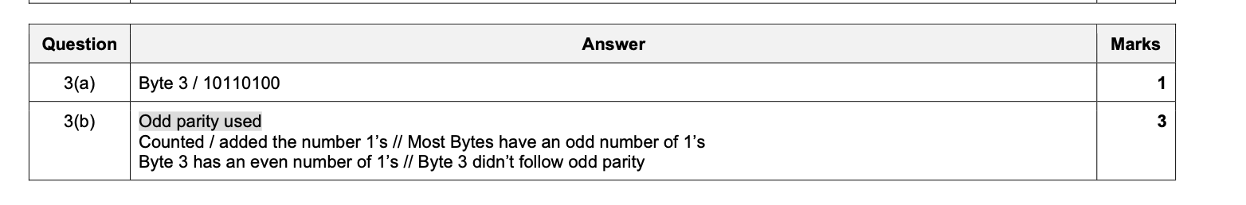

Slide 37
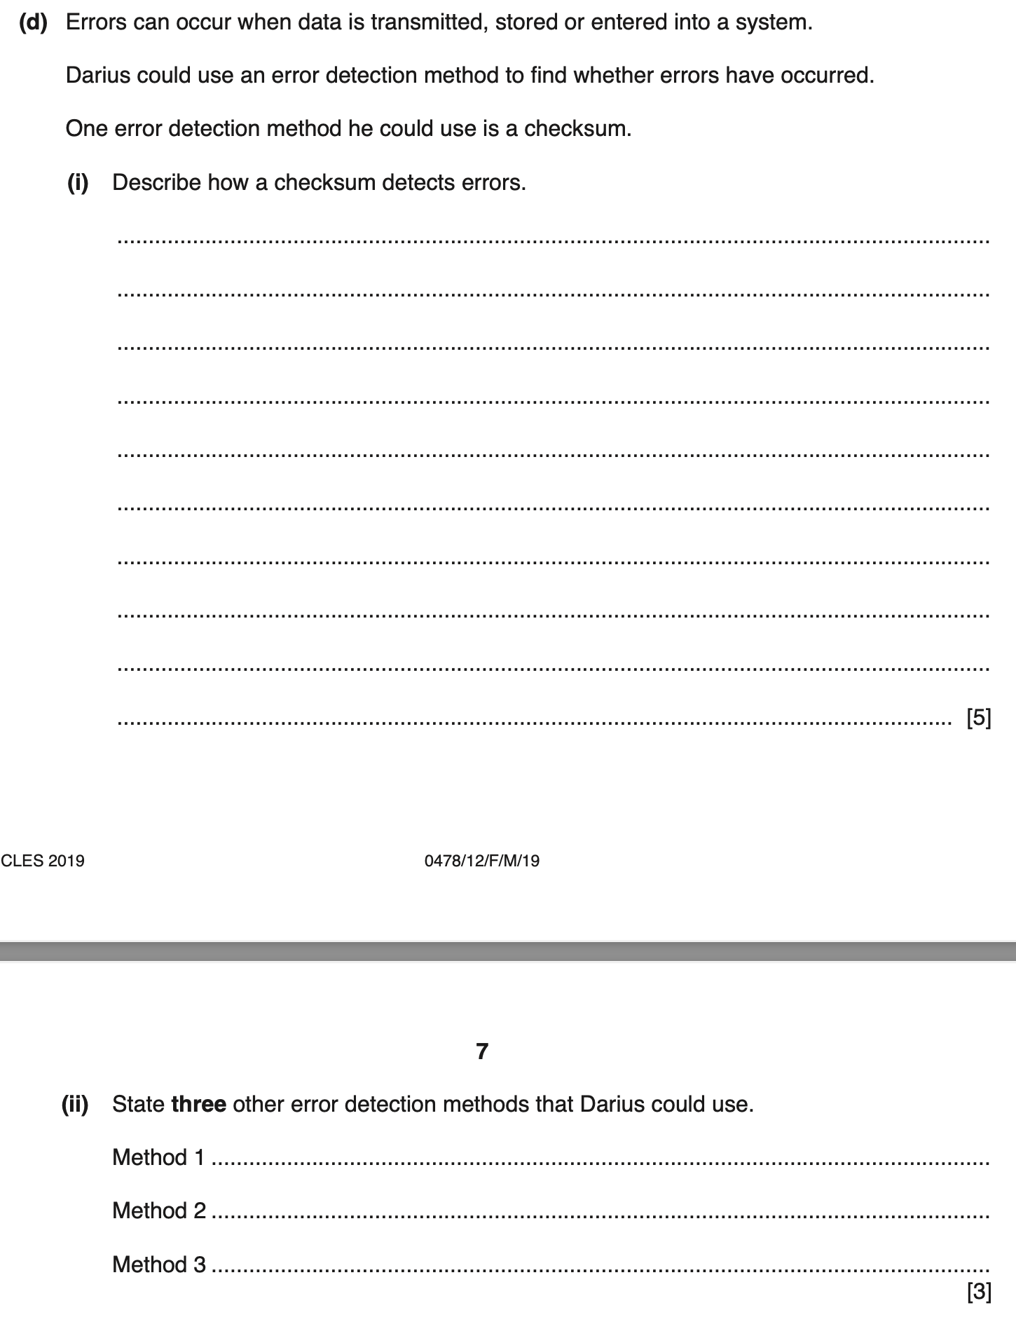
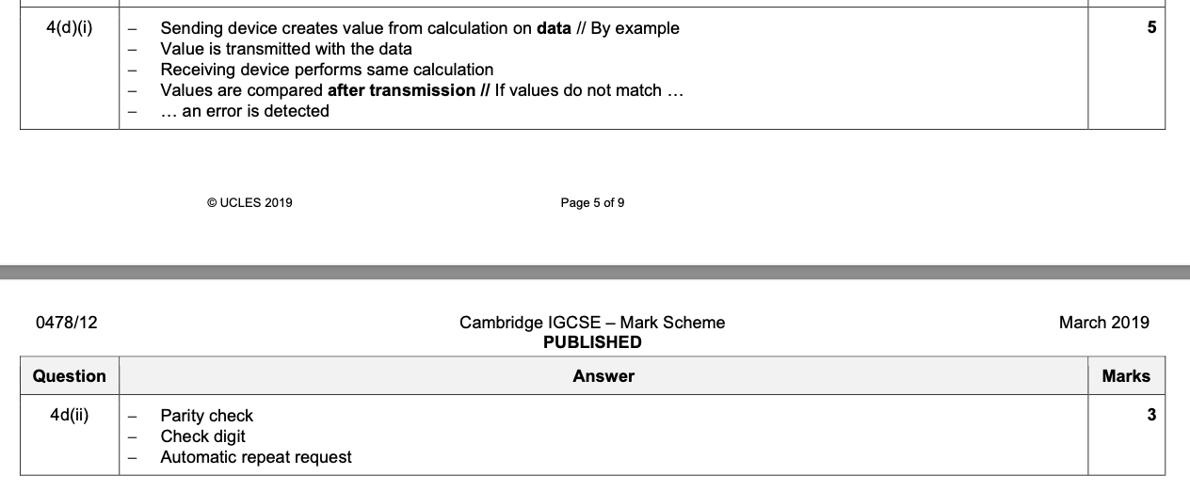

Slide 38
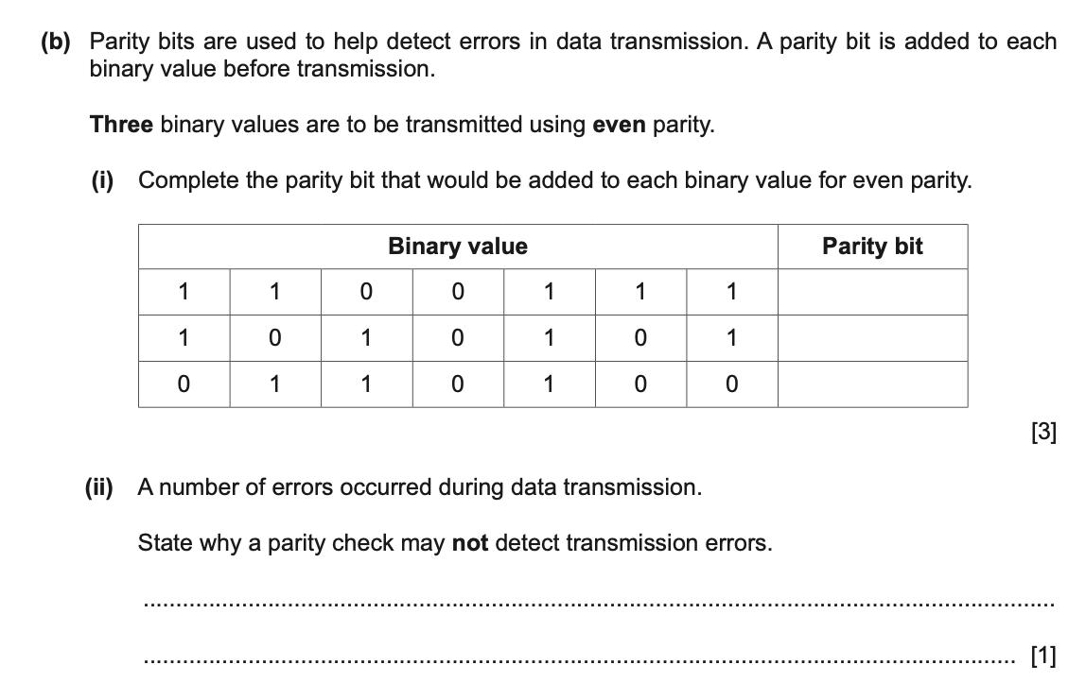
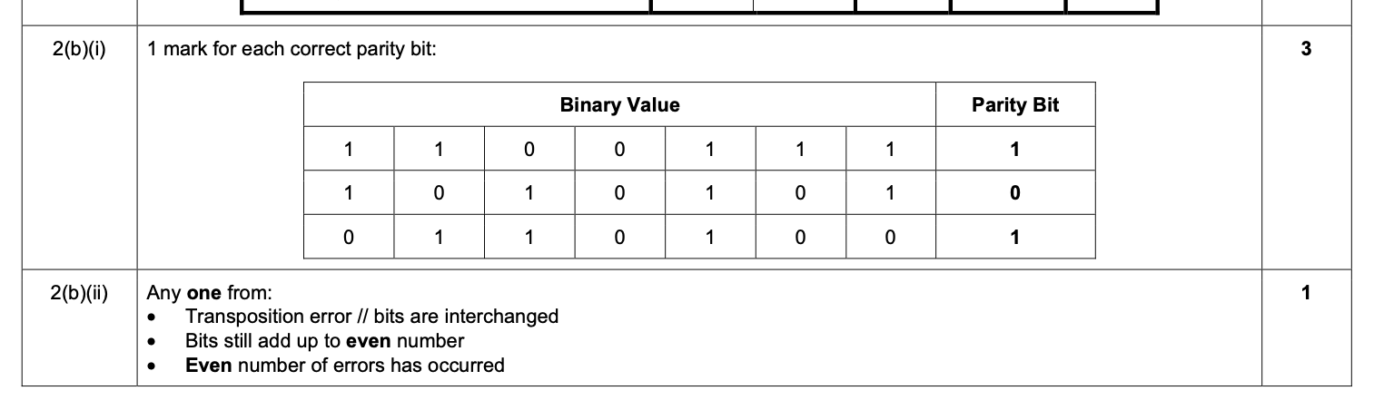

Slide 39
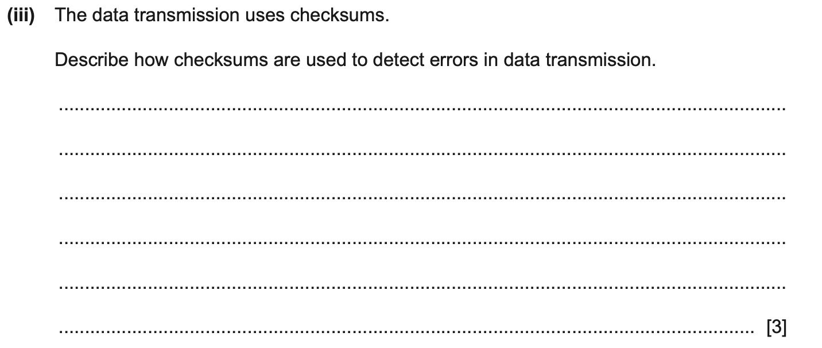
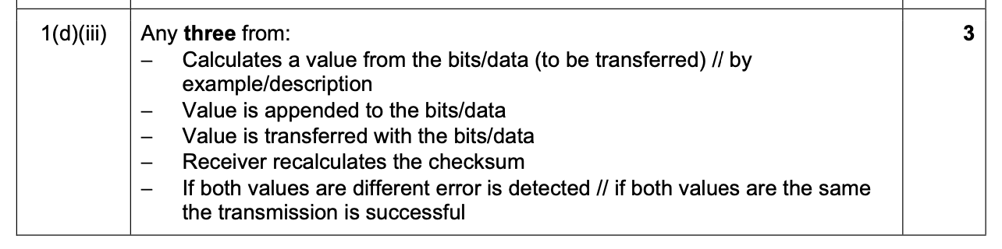

Slide 40
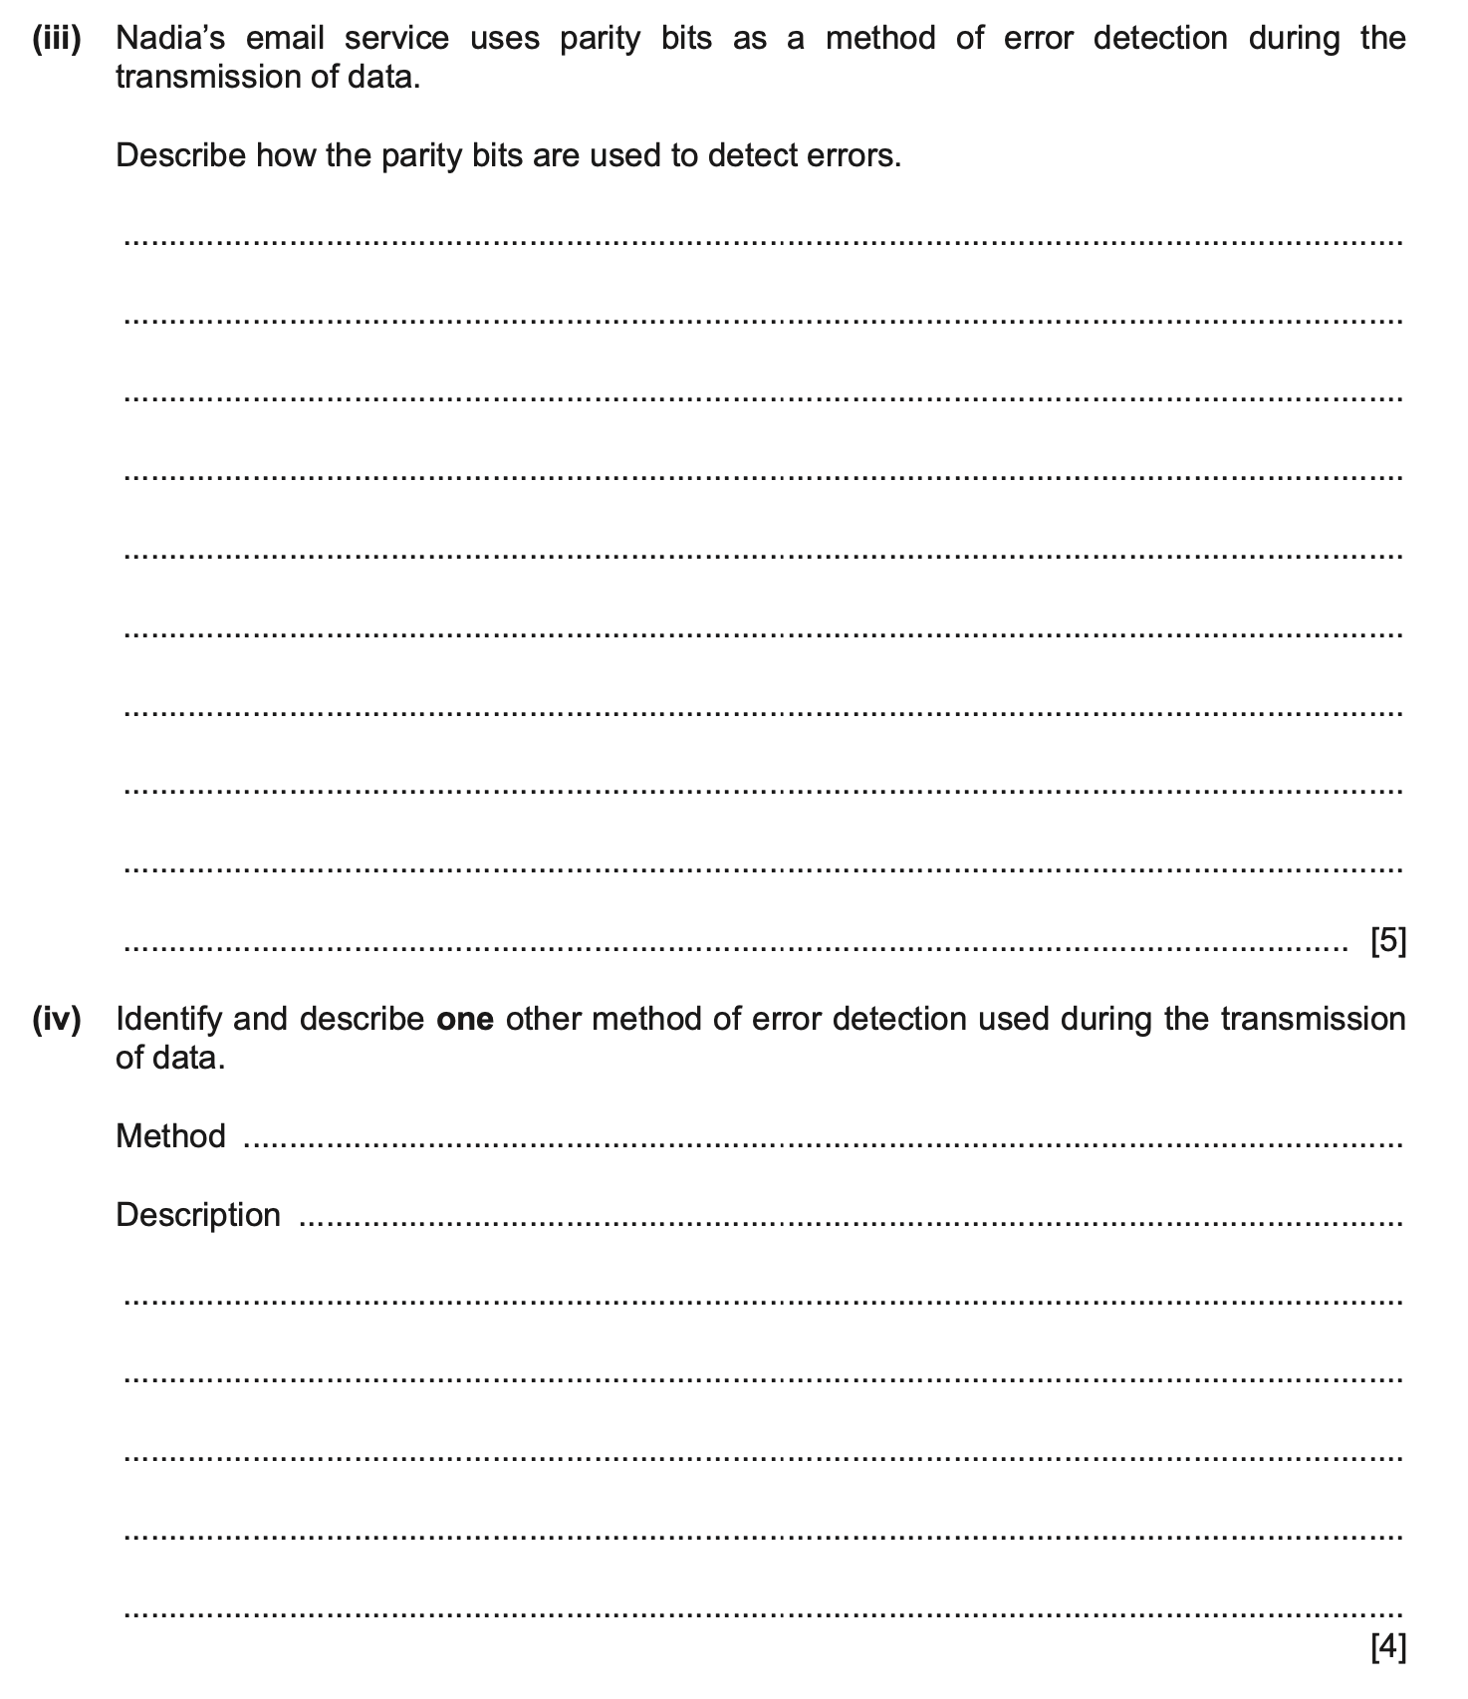
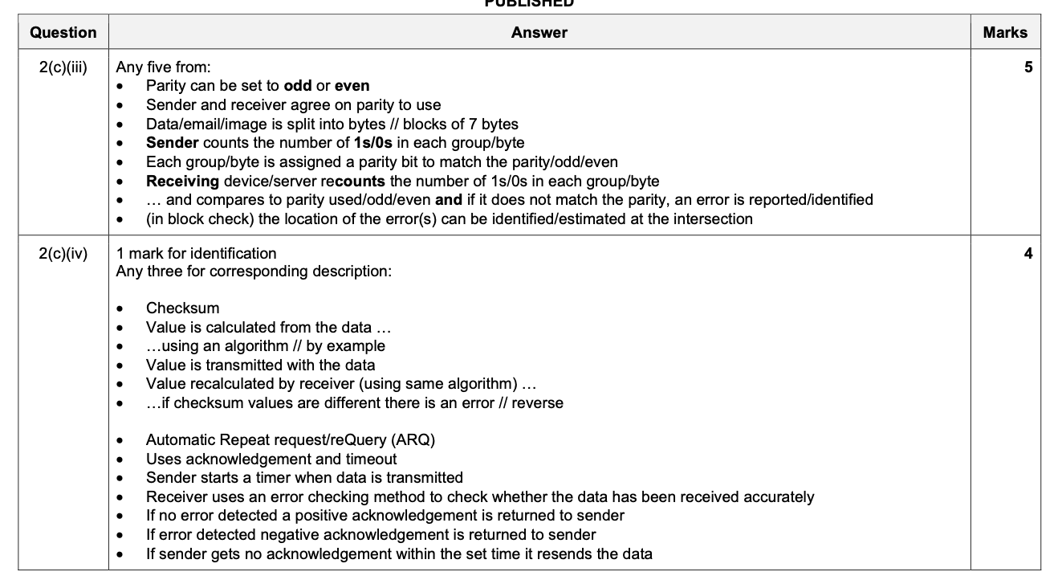

Slide 41
